Slide 1
Skills Bootcamp Classroom Rules
Be on time: Just like in a physical classroom, it's important to be punctual for your online class. Log in to the virtual classroom a few minutes before the class starts.
Turn Cameras on: In order to maximise your learning studies show that being able to see your peers and your tutor being able to see you can increase motivations and retention, therefore we ask to keep your cameras on.
Attend all classes: In order to be successful in your bootcamp studies you need to attend all live sessions, therefore you should prioritise and make time for these sessions.
Avoid distractions: Turn off your phone notifications, close any other unnecessary tabs, and focus solely on the class.
Participate actively: It's important to be an active participant in the class. Ask questions, answer questions, and participate in discussions.
Use proper language and tone: Use respectful language and tone when communicating with your classmates and instructor. Avoid using slang or inappropriate language.
Respect others' opinions: Be respectful of others' opinions, even if they differ from your own. Avoid making negative comments or attacking others.
Follow the instructor's guidelines: Follow the instructor's guidelines, such as submitting assignments on time.
Be polite: Be polite and respectful to everyone in the class, including the instructor, classmates, and guest speakers.
Dress appropriately: Even though you are not in a physical classroom, it's important to dress appropriately. Dress as if you were going to a face-to-face class.
Use appropriate technology: Ensure that you have the necessary equipment, such as a reliable internet connection, a microphone, and a webcam, and that they are in good working condition.

Slide 2
Software Developer Bootcamp
Unit 1 – Introduction to Software Development
Week 1B
Notes:
Good morning/afternoon everyone. Today we'll delve into the role of software in various industries, understand their primary purposes, and classify them based on their target audiences.

Slide 3
Learning Outcomes
By the end of this session, you will be able to:
Describe the purpose of developing software.
Describe how the primary software in each industry impacts daily operations.
Evaluate the potential consequences if the primary software in one of the identified industries fails.
Articulate the key benefits of using industry-specific software as opposed to generic software.

Slide 4
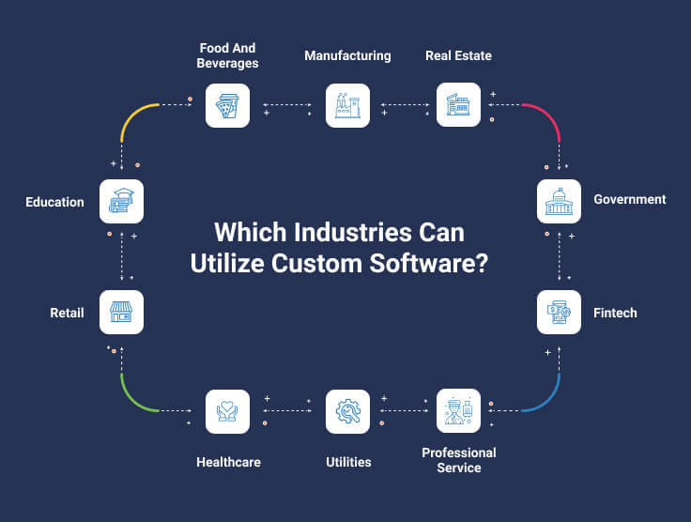
The Purpose of Developing Software
Solve Specific Problems
Streamline Processes
Enhance User Experience
Drive Business Growth
Thank of more uses
Notes:
Software development is a process that involves many different steps, including:
Requirements gathering: This is the process of understanding the needs of the users and stakeholders of the software.
Design: This is the process of creating a blueprint for the software, including its architecture, user interface, and functionality.
Development: This is the process of coding the software according to the design.
Testing: This is the process of ensuring that the software meets its requirements and is free of defects.
Deployment: This is the process of making the software available to users.
Maintenance: This is the process of fixing defects and adding new features to the software.

Slide 5
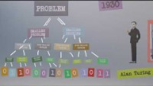
History of Developing Software Video
Notes:
Today we'll start by exploring why software development is crucial. From solving specific issues to propelling business growth, software is at the heart of many modern solutions.

Slide 6
Group Activity - Identifying Purpose
Activity: Choose an industry and discuss the challenges and opportunities of developing software for a specific industry.
Work in groups.
Notes:
This activity helps highlight the various reasons behind software development. It will also demonstrate the diverse range of purposes software serves in our daily lives.

Slide 7
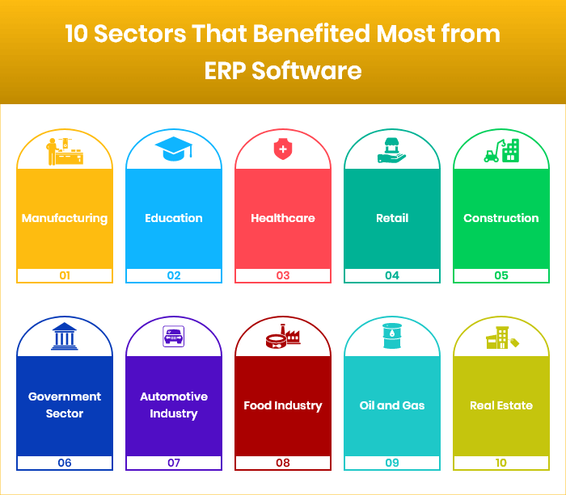
Primary Software in Various Industries
Financial industry: Software for tracking transactions, managing risk, and complying with regulations.
Healthcare industry: Software for storing patient records, managing appointments, and prescribing medications.
Notes:
https://www.mavencluster.com/blog/10-industries-need-erp-software/
The specific software used in each industry will vary depending on the specific needs of the industry.
However, there are some common types of software that are used in many industries, such as:
Enterprise resource planning (ERP) software: This software helps businesses manage their finances, inventory, human resources, and other operations.
Customer relationship management (CRM) software: This software helps businesses manage their customer interactions, including sales, marketing, and customer support.
Human capital management (HCM) software: This software helps businesses manage their employees, including payroll, benefits, and performance management.
Supply chain management (SCM) software: This software helps businesses manage the flow of goods and materials from suppliers to customers.
Business intelligence (BI) software: This software helps businesses to collect, analyse, and visualise data in order to make better decisions.

Slide 8
Primary Software in Various Industries
Retail industry: Software for tracking inventory, managing customer orders, and processing payments.
Manufacturing industry: Software for designing products, scheduling production, and controlling quality.
Notes:
The specific software used in each industry will vary depending on the specific needs of the industry.
However, there are some common types of software that are used in many industries, such as:
Enterprise resource planning (ERP) software: This software helps businesses manage their finances, inventory, human resources, and other operations.
Customer relationship management (CRM) software: This software helps businesses manage their customer interactions, including sales, marketing, and customer support.
Human capital management (HCM) software: This software helps businesses manage their employees, including payroll, benefits, and performance management.
Supply chain management (SCM) software: This software helps businesses manage the flow of goods and materials from suppliers to customers.
Business intelligence (BI) software: This software helps businesses to collect, analyse, and visualise data in order to make better decisions.

Slide 9
Primary Software in Various Industries
Transportation industry: Software for managing fleets, tracking shipments, and scheduling deliveries.
Energy industry: Software for monitoring power grids, optimising production, and managing emissions.
Notes:
Software has permeated every industry. From healthcare to education, it plays a pivotal role in daily operations.

Slide 10
Primary Software in Various Industries
Government: Software for managing finances, delivering services, and enforcing regulations.
Education: Software for delivering instruction, managing student records, and tracking progress.
Notes:
Software has permeated every industry. From healthcare to education, it plays a pivotal role in daily operations.

Slide 11
Primary Software in Various Industries
Media and entertainment: Software for creating and distributing content, managing marketing campaigns, and tracking audience engagement.
Notes:
Software has permeated every industry. From healthcare to education, it plays a pivotal role in daily operations.

Slide 12
Case Study: Impact of EHRs in Healthcare
Electronic Health Records (EHRs) have drastically changed the healthcare landscape.
Case Details:
Hospital A implemented an EHR system.
Streamlined patient information management.
Reduced errors and improved patient care.
However, faced challenges in training staff.
Notes:
This case study highlights both the benefits and challenges of implementing software in critical industries like healthcare.

Slide 13
Case Study: Impact of EHRs in Healthcare
What benefits and challenges this case study does highlight?
You will work in groups and share your findings in the chat.
Notes:
This case study highlights both the benefits and challenges of implementing software in critical industries like healthcare.

Slide 14
Consequences of Software Failures
Lost revenue: When software fails, it can lead to lost revenue due to delayed transactions, inability to complete orders or loss of customers.
Productivity loss: Software failure can also lead to productivity loss due to employees having to spend time troubleshooting problems or manually completing tasks that the software was supposed to automate.
Notes:
When software fails, the repercussions can be enormous, affecting both businesses and their customers.

Slide 15
Consequences of Software Failures
Customer dissatisfaction: Software failure can lead to customer dissatisfaction due to delays, errors, or inability to use the software.
Legal liability: In some cases, software failure can even result in legal liability if it results in financial losses or physical harm to customers.
Notes:
When software fails, the repercussions can be enormous, affecting both businesses and their customers.

Slide 16
Case Study - A Banking Software Failure
Real-life banking software glitch leading to multiple issues.
Read this article: https://www.nytimes.com/2019/07/29/business/capital-one-data-breach-hacked.html
What are the three main types of software glitches?
What are some of the consequences of software glitches?
What can be done to prevent software glitches?
Notes:
This case study highlights how a minor glitch can lead to massive problems, emphasising the importance of robust software development and testing.
What are the three main types of software glitches?
Data corruption: This occurs when data is accidentally changed or deleted.
Logic errors: These are errors in the code that cause the software to behave in an unexpected way.
Performance issues: These are problems that cause the software to run slowly or crash.
What are some of the consequences of software glitches?
Financial losses: Software glitches can cause businesses to lose money by disrupting operations or exposing customer data.
Safety hazards: Software glitches can lead to safety hazards by causing equipment to malfunction or fail.
Reputational damage: Software glitches can damage a company's reputation by making it look unreliable or incompetent.
What can be done to prevent software glitches?
Use high-quality software: Only use software from reputable vendors that have a good track record of quality control.
Perform regular testing: Test software thoroughly before deploying it to production.
Have a robust bug reporting system: Make it easy for users to report bugs so that they can be fixed quickly.

Slide 17
Group Activity - Consequences Discussion
Activity: Consequences of Software Failures
Instructions:
Break into groups.
Discuss a software failure you've experienced or heard of.
List down its consequences and discuss its impact.
Share your stories and findings with the class.
Notes:
This activity emphasizes the real-world implications of software failures and how they can have cascading effects on businesses and individuals.

Slide 18
Benefits of Industry-specific Software
Tailored Solutions
Higher Efficiency
Better Integration with Existing Systems
Competitive Advantage
Notes:
Industry-specific software offers solutions tailored to specific industry needs, resulting in better performance and a competitive edge.

Slide 19
Generic vs. Industry-specific Software
Generic: Broad Features, Less Specialised
Industry-specific: Focused Features, Deep Integration
Notes:
While generic software can serve multiple industries, they often lack the specialised features that industry-specific software provides.

Slide 20
Case Study: Generic vs. Industry-specific Software in Retail
A retail chain opted for a generic ERP system over a retail-specific one.
Outcomes:
The generic system lacked retail-specific features.
Integration issues with other retail tools.
The company had to invest more in customising the generic software.
Notes:
This case study underscores the importance of choosing the right software solution, tailored to industry-specific needs, to avoid unnecessary costs and challenges.

Slide 21
Lost in translation
The first ever programs were written solely in machine code.
Each instruction was entered by hand before being executed.
Operation code (opcode) tables were used to help with this, but it was still very time consuming.
100010110101010111111100
100010110100010111111000
111010000
100010010100010111110100
Notes:
Opcode tables list the operations that could be performed by the CPU.

Slide 22
Lost in translation
To speed things up, programmers developed an assembly language.
This made the opcodes easier to read by using a mnemonic and an operand to form an instruction.
100010110101010111111100
100010110100010111111000
111010000
100010010100010111110100

Slide 23
Lost in translation
To speed things up, programmers developed an assembly language.
This made the opcodes easier to read by using a mnemonic and an operand to form an instruction.
Each line of assembly language was equivalent to one line of machine code.
mov edx,DWORD PTR [rbp-0x4]
mov eax,DWORD PTR [rbp-0x8]
add eax,edx
mov DWORD PTR [rbp-0xc],eax

Slide 24
Lost in translation
mov edx,DWORD PTR [rbp-0x4]
mov eax,DWORD PTR [rbp-0x8]
add eax,edx
mov DWORD PTR [rbp-0xc],eax
100010110101010111111100
100010110100010111111000
111010000
100010010100010111110100
This was great for the programmers, but the computers still couldn’t understand the instructions.
Assemblers were created to automatically translate the assembly language into machine code.
Assembler

Slide 25
Lost in translation
Assembly Language
mov edx,DWORD PTR [rbp-0x4]
Machine Code
100010110101010111111100
Assembly language and machine code are low-level languages.
Each line of assembly language is equivalent to one line of machine code.
The code is specific to the CPU that it is written for.

Slide 26
Learning Outcomes
By the end of this session, you will be able to:
Describe the purpose of developing software.
Describe how the primary software in each industry impacts daily operations.
Evaluate the potential consequences if the primary software in one of the identified industries fails.
Articulate the key benefits of using industry-specific software as opposed to generic software.

Slide 27
Thank you.
Any questions?

